Slide 1



PROTECTING YOURSELF FROM PHISHING ATTACKS
Pragya Tripathi

Slide 2
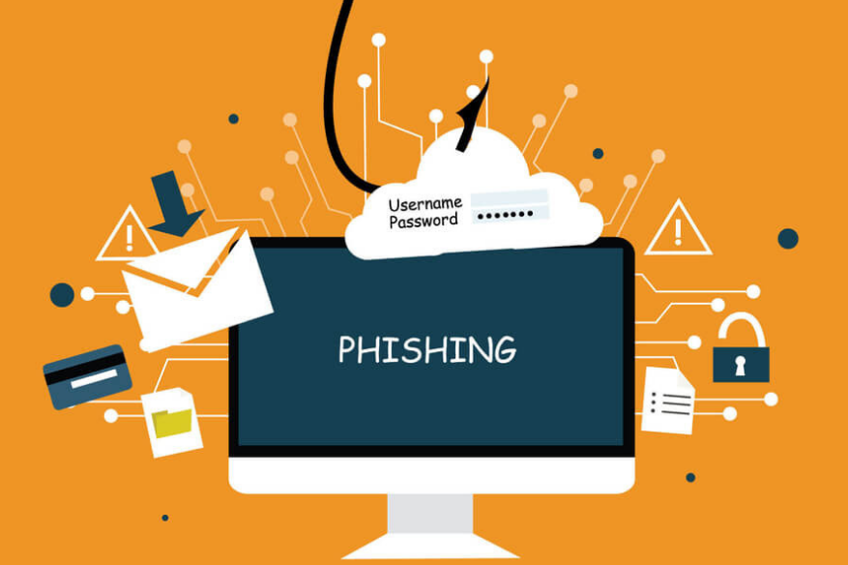
INTRODUCTION
Phishing is a common threat, involves impersonation to obtain sensitive information, often passwords.
Attackers use deceptive links and attachments, costing companies millions and risking employee safety.
Our goal is to keep both the business and the staff safe from harm.

Slide 3
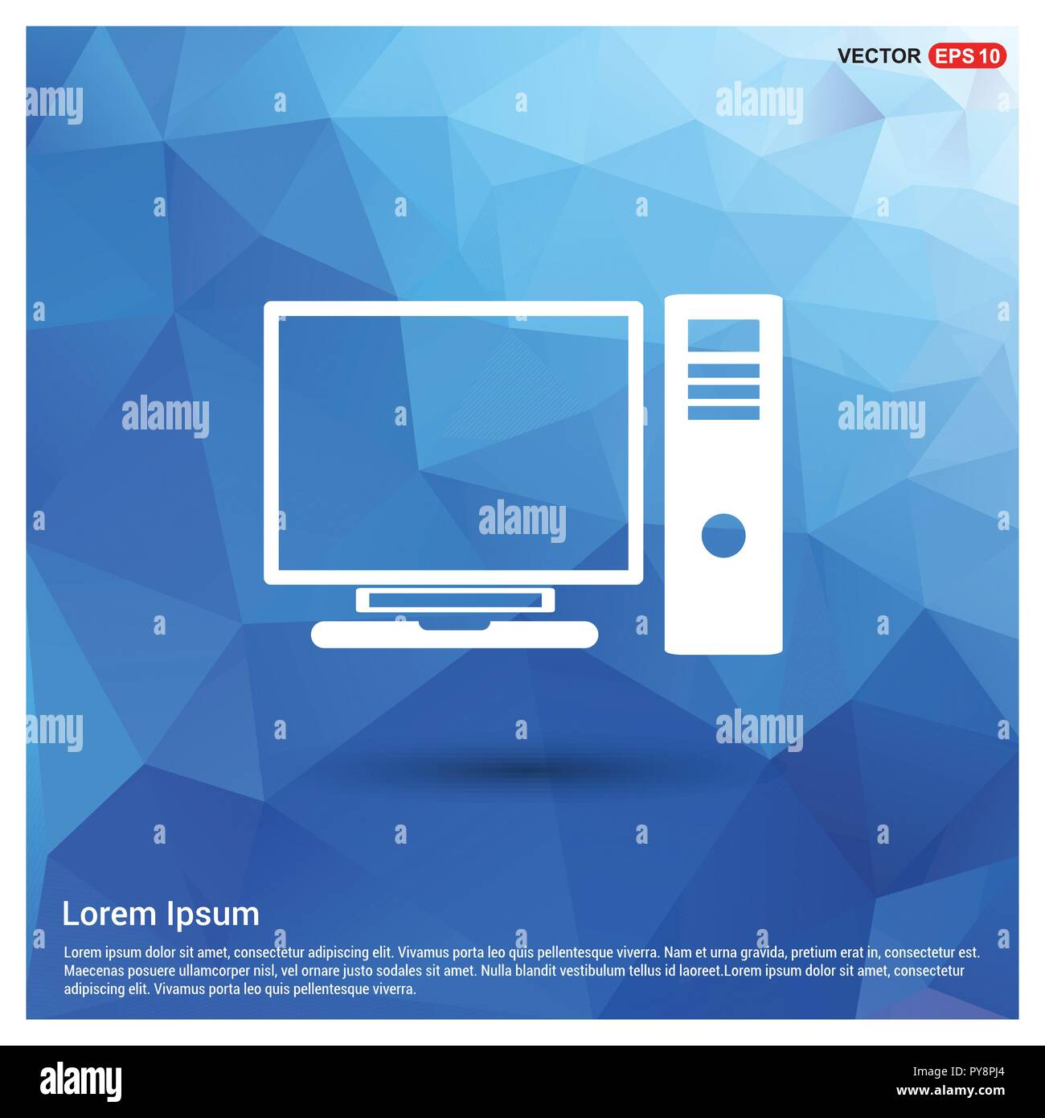

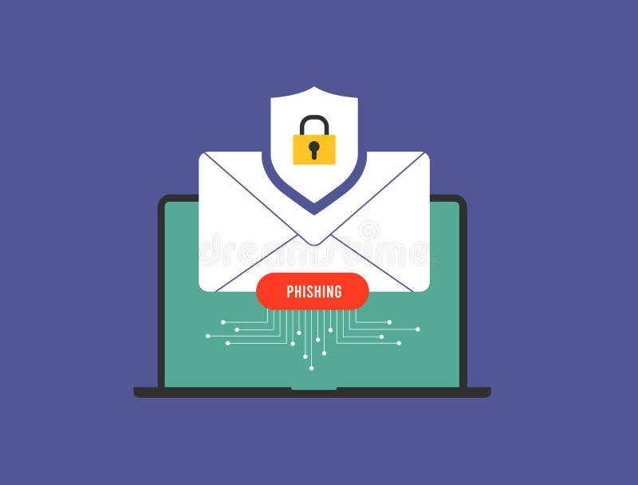
TYPES OF PHISHING ATTACKS
Manipulate individuals to divulge confidential information.
Examples: Impersonation, emotional manipulation.
Website phishing
Fraudulent websites imitating legitimate ones.
Examples: Fake login pages, malicious websites.
Email phishing
Deceptive email to extract information.
Examples: fake security alerts, account verification requests.
Social Engineering

Slide 4


COMMON CHARACTERISTICS OF PHISHING ATTEMPTS
Urgency: Creating a sense of immediate action.
Unexpected Email: Receiving unsolicited emails.
Suspicious Links: Hover over links to preview URLs.
Requests for personal information: Be cautious.

Slide 5

RECOGNIZING PHISHING EMAILS
Check the Sender’s
Email Address.
Verify email
content.
Look for spelling and grammar mistakes.
Hover over links to preview URLs.

Slide 6

RECOGNIZING PHISHING WEBSITES
Check the URLs.
Verify website legitimacy.
Looks for HTTPS.
Be cautious with pop- Up forms.

Slide 7

SOCIAL ENGINEERING TACTICS
Impersonation techniques.
Exploiting human emotions.
Manipulation of trust.
Awareness of social media manipulation

Slide 8



FINAL WORDS
Phishing attacks will continue to happen in the future. It is up to the organization and its employees to learn from past mistakes and not repeat them. Employees can educate themselves on how to stop phishing emails. Organizations can deploy the best phishing protection solutions to deal with such situations effectively. Furthermore, organizations must include case studies related to past incidents in the employee education and training programs.

Slide 9


